Slide 1
Instructor Materials Chapter 2: The Cybersecurity Sorcery Cube
Cybersecurity Essentials v1.0
Notes:
Cisco Networking Academy Program
Cybersecurity Essentials
Chapter 2: The Cybersecurity Sorcery Cube

Slide 2
Instructor Materials - Chapter 2 Planning Guide
This PowerPoint deck is divided in two parts:
Instructor Planning Guide
Information to help you become familiar with the chapter
Teaching aids
Instructor Class Presentation
Optional slides that you can use in the classroom
Begins on slide #12
Note: Remove the Planning Guide from this presentation before sharing with anyone.
Notes:
2

Slide 3
Cybersecurity Essentials v1.0
Planning Guide
Chapter 2: The Cybersecurity Sorcery Cube
Notes:
Cybersecurity Essentials v1.0 Planning Guide
Chapter 2: The Cybersecurity Sorcery Cube

Slide 4
Chapter 2: Activities
What activities are associated with this chapter?
The password used in the Packet Tracer activities in this chapter is:
Page Number | Activity Type | Activity Name
2.2.3.4 | IA | Identify the Principles of Information Security
2.3.3.3 | IA | Identify the Data State
2.4.3.5 | IA | Identify the Countermeasure Category
2.4.3.6 | Lab | The Cybersecurity Sorcery Cube Scatter Quizlet
2.5.1.5 | IA | Identify the ISO/IEC 27000 Domains and Controls
Notes:
4

Slide 5
Chapter 2: Activities (Cont.)
What activities are associated with this chapter?
Page Number | Activity Type | Activity Name
2.5.2.4 | Lab | Exploring Authentication, Authorization, and Accounting
2.5.2.5 | Packet Tracer | Exploring File and Data Encryption
2.5.2.6 | Packet Tracer | Using File and Data Integrity Checks
The password used in the Packet Tracer activities in this chapter is: PT_cyber1
Notes:
5

Slide 6
Chapter 2: Assessment
Students should complete Chapter 2, “Assessment” after completing Chapter 2.
Quizzes, labs, Packet Tracers and other activities can be used to informally assess student progress.
Notes:
6

Slide 7
Chapter 2: Best Practices
Prior to teaching Chapter 2, the instructor should:
Complete Chapter 2, “Assessment.”
The concepts and topics covered here will follow the students through their cybersecurity career. Make sure to take your time to eliminate any misconceptions.
This chapter introduces the three dimensions of the cybersecurity in the form of a sorcery cube. Emphasize how each of the three dimensions contributes to overall security.
The chapter also introduces the ISO cybersecurity model. The model represents an international framework to standardize the management of information systems. Describe each of the twelve domains.
Notes:
7

Slide 8
Chapter 2: Best Practices (Cont.)
This slide can be used to start a class discussion.
Introduce the three dimensions of the cybersecurity sorcery cube. Challenge the students to give examples of security controls for all 27 intersections of the cube.
Example: Transmission – Integrity – Policies and Practice
All employees must used approved VPN communications when transmitting company data to or from the organizations or people within the organization.
Notes:
8

Slide 9
Chapter 2: Best Practices (Cont.)
Encourage students to explore each of the major topics in this chapter. The McCumber cube was establish in 1991 and the Internet is full of great resources for deeper exploration. The CIA Triad is the foundation of all cybersecurity concepts.
Cybersecurity Principles | URL Address
McCumber Cube | http://sachin-cis608.blogspot.com/2015/09/mccumber-cube-to-model-network-defense.html
CIA TRIAD | http://www.techrepublic.com/blog/it-security/the-cia-triad/
Cybersecurity Related Laws | http://cyber.laws.com/
ISO/IEC 27000 | http://www.27000.org/
Notes:
9
This slide can be used to foment class discussion. It should help the students to understand the opportunities to get involve in student competitions.

Slide 10
Chapter 2: Additional Help
For additional help with teaching strategies, including lesson plans, analogies for difficult concepts, and discussion topics, visit the Cybersecurity Essentials Community at community.netacad.net.
If you have lesson plans or resources that you would like to share, upload them to the Cybersecurity Essentials Community in order to help other instructors.
Notes:
10

Slide 11
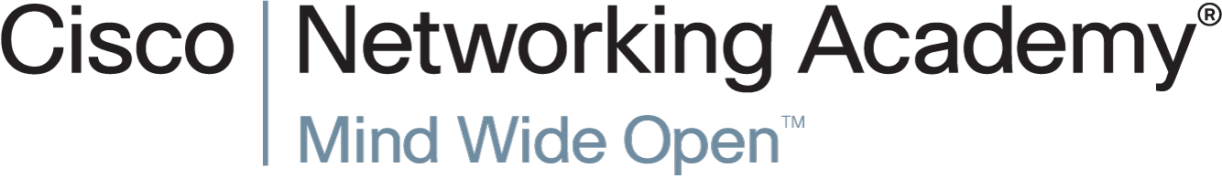

Slide 12
Chapter 2: The Cybersecurity Sorcery Cube
Cybersecurity Essentials v1.0
Notes:
Cisco Networking Academy Program
Cybersecurity Essentials v1.0
Chapter 2: The Cybersecurity Sorcery Cube

Slide 13
Chapter 2 - Sections & Objectives
2.1 The Cybersecurity Sorcery Cube
Describe the three dimensions of the McCumber Cube.
2.2 CIA TRIAD
Describe the principles of confidentiality, integrity, and availability.
2.3 States of Data
Differentiate the three states of data.
2.4 Cybersecurity Countermeasures
Compare the types of cybersecurity countermeasures.
2.5 IT Security Management Framework
Describe the ISO Cybersecurity Model
Notes:
13

Slide 14
2.1 The Cybersecurity Sorcery Cube
Notes:
Cisco Networking Academy Program
Cybersecurity Essentials
Chapter 2: The Cybersecurity Sorcery Cube

Slide 15
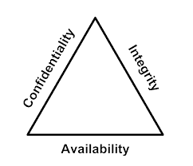
The Cybersecurity Sorcery Cube The Three Dimensions
The Principles of Security
The first dimension of the cybersecurity sorcery cube identifies the goals to protect the cyber world. The goals identified in the first dimension are the foundational principles of the cybersecurity world.
These three principles are confidentiality, integrity and availability.
The principles provide focus and enable the cyber wizard to prioritize actions in protecting the cyber world.
Use the acronym CIA to remember these three principles.
The States of Data
The cyber world is a world of data; therefore, cyber wizards focus on protecting data. The second dimension of the cybersecurity sorcery cube focuses on the problems of protecting all of the states of data in the cyber world. Data has three possible states:
1) Data at rest or in storage 2) Data in transit 3) Data in process

Slide 16
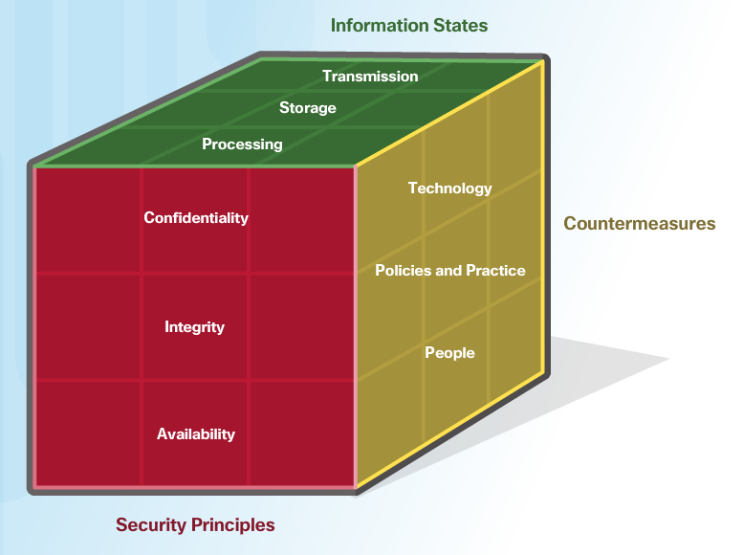
The Cybersecurity Sorcery Cube The Three Dimensions (Cont.)
Cybersecurity Safeguards
The third dimension of the cybersecurity sorcery cube defines the types of powers used to protect the cyber world. The sorcery cube identifies the three types of powers:
Technologies - devices, and products available to protect information systems and fend off cyber criminals.
Policies and Practices - procedures, and guidelines that enable the citizens of the cyber world to stay safe and follow good practices.
People - Aware and knowledgeable about their world and the dangers that threaten their world.

Slide 17
2.2 CIA TRIAD
Notes:
Cisco Networking Academy Program
Cybersecurity Essentials
Chapter 2: The Cybersecurity Sorcery Cube

Slide 18

CIA TRIAD Confidentiality
The Principle of Confidentiality
Confidentiality prevents the disclosure of information to unauthorized people, resources and processes. Another term for confidentiality is privacy.
Organizations need to train employees about best practices in safeguarding sensitive information to protect themselves and the organization from attacks.
Methods used to ensure confidentiality include data encryption, authentication, and access control.
Protecting Data Privacy
Organizations collect a large amount of data and much of this data is not sensitive because it is publicly available, like names and telephone numbers.
Other data collected, though, is sensitive. Sensitive information is data protected from unauthorized access to safeguard an individual or an organization.

Slide 19
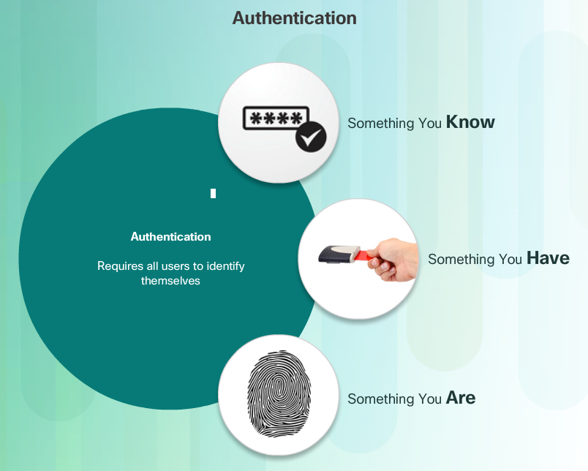
CIA TRIAD Confidentiality (Cont.)
Controlling Access
Access control defines a number of protection schemes that prevent unauthorized access to a computer, network, database, or other data resources. The concepts of AAA involve three security services: Authentication, Authorization and Accounting. Authentication verifies the identity of a user to prevent unauthorized access. Users prove their identity with a username or I.D.
Authorization services determine which resources users can access, along with the operations that users can perform. Authorization can also control when a user has access to a specific resource.
Accounting keeps track of what users do, including what they access, the amount of time they access resources, and any changes made.

Slide 20
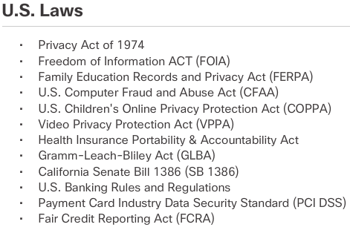
CIA TRIAD Confidentiality (Cont.)
Confidentiality and privacy seem interchangeable, but from a legal standpoint, they mean different things.
Most privacy data is confidential, but not all confidential data is private. Access to confidential information occurs after confirming proper authorization. Financial institutions, hospitals, medical professionals, law firms, and businesses handle confidential information.
Confidential information has a non-public status. Maintaining confidentiality is more of an ethical duty.
Privacy is the appropriate use of data. When organizations collect information provided by customers or employees, they should only use that data for its intended purpose.

Slide 21
CIA TRIAD Integrity
Principle of Data Integrity
Integrity is the accuracy, consistency, and trustworthiness of data during its entire life cycle.
Another term for integrity is quality.
Methods used to ensure data integrity include hashing, data validation checks, data consistency checks, and access controls.
Need for Data Integrity
The need for data integrity varies based on how an organization uses data. For example, Facebook does not verify the data that a user posts in a profile.
A bank or financial organization assigns a higher importance to data integrity than Facebook does. Transactions and customer accounts must be accurate.
Protecting data integrity is a constant challenge for most organizations. Loss of data integrity can render entire data resources unreliable or unusable.
Integrity Checks
An integrity check is a way to measure the consistency of a collection of data (a file, a picture, or a record). The integrity check performs a process called a hash function to take a snapshot of data at an instant in time.

Slide 22
CIA TRIAD Availability
Data availability is the principle used to describe the need to maintain availability of information systems and services at all times. Cyberattacks and system failures can prevent access to information systems and services.
Methods used to ensure availability include system redundancy, system backups, increased system resiliency, equipment maintenance, up-to-date operating systems and software, and plans in place to recover quickly from unforeseen disasters.
High availability systems typically include three design principles: eliminate single points of failure, provide for reliable crossover, and detect failures as they occur.
Organizations can ensure availability by implementing the following:
Equipment maintenance
OS and system updates
Test backups
Plan for disasters
Implement new technologies
Monitor unusual activity
Test to verify availability

Slide 23
2.3 States of Data
Notes:
Cisco Networking Academy Program
Cybersecurity Essentials
Chapter 2: The Cybersecurity Sorcery Cube

Slide 24

States of Data Data at Rest
Stored data refers to data at rest. Data at rest means that a type of storage device retains the data when no user or process is using it.
A storage device can be local (on a computing device) or centralized (on the network). A number of options exist for storing data.
Direct-attached storage (DAS) is storage connected to a computer. A hard drive or USB flash drive is an example of direct-attached storage.

Slide 25

States of Data Data at Rest (Cont.)
Redundant array of independent disks (RAID) uses multiple hard drives in an array, which is a method of combining multiple disks so that the operating system sees them as a single disk. RAID provides improved performance and fault tolerance.
A network attached storage (NAS) device is a storage device connected to a network that allows storage and retrieval of data from a centralized location by authorized network users. NAS devices are flexible and scalable, meaning administrators can increase the capacity as needed.
A storage area network (SAN) architecture is a network-based storage system. SAN systems connect to the network using high-speed interfaces allowing improved performance and the ability to connect multiple servers to a centralized disk storage repository.

Slide 26
States of Data Data In Transit
Data transmission involves sending information from one device to another. There are numerous methods to transmit information between devices including:
Sneaker net – uses removable media to physically move data from one computer to another
Wired networks – uses cables to transmit data
Wireless networks – uses the airwaves to transmit data
The protection of transmitted data is one of the most challenging jobs of a cybersecurity professional. The greatest challenges are:
Protecting data confidentiality – cyber criminals can capture, save and steal data in-transit.
Protecting data integrity – cyber criminals can intercept and alter data in-transit.
Protecting data availability - cyber criminals can use rogue or unauthorized devices to interrupt data availability.

Slide 27
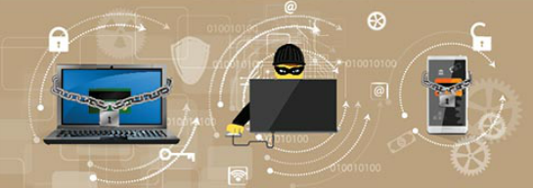
States of Data Data In Process
The third state of data is data in process. This refers to data during initial input, modification, computation, or output.
Protection of data integrity starts with the initial input of data.
Organizations use several methods to collect data, such as manual data entry, scanning forms, file uploads, and data collected from sensors.
Each of these methods pose potential threats to data integrity.
Data modification refers to any changes to the original data such as users manually modifying data, programs processing and changing data, and equipment failing resulting in data modification.
Processes like encoding/decoding, compression/decompression and encryption/decryption are all examples of data modification. Malicious code also results in data corruption.

Slide 28
2.4 Cybersecurity Countermeasures
Notes:
Cisco Networking Academy Program
Cybersecurity Essentials
Chapter 2: The Cybersecurity Sorcery Cube

Slide 29
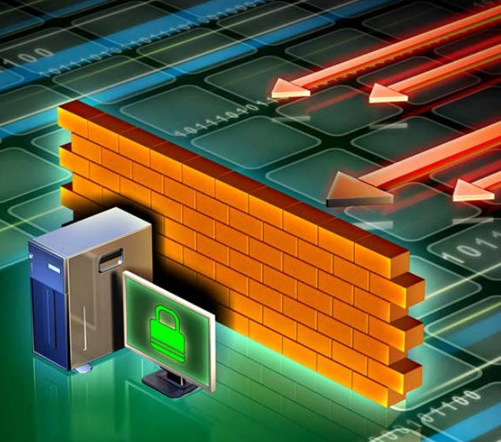
Cybersecurity Countermeasures Technologies
Software-based Technology Safeguards
Software safeguards include programs and services that protect operating systems, databases, and other services operating on workstations, portable devices, and servers. There are several software-based technologies used to safeguard an organization’s assets.
Hardware-based Technology Safeguards
Hardware based technologies are appliances that are installed within the network faculties. They can include: Firewall appliances, Intrusion Detection Systems (IDS),Intrusion Prevention Systems (IPS) and Content filtering systems.

Slide 30
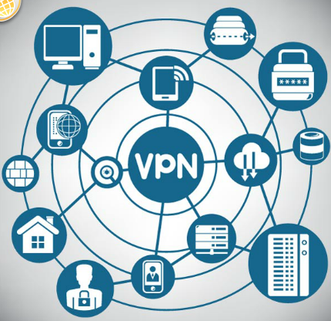
Cybersecurity Countermeasures Technologies
Network-based Technology Safeguards
Technological countermeasures can also include network-based technologies.
Virtual Private Network (VPN) is a secure virtual network that uses the public network (i.e., the Internet). The security of a VPN lies in the encryption of packet content between the endpoints that define the VPN.
Network access control (NAC) requires a set of checks before allowing a device to connect to a network. Some common checks include up-to-data antivirus software or operating system updates installed.
Wireless access point security includes the implementation of authentication and encryption.

Slide 31

Cybersecurity Countermeasures Technologies
Cloud-based Technology Safeguards
Technological countermeasures now also include cloud-based technologies. Cloud-based technologies shift the technology component from the organization to the cloud provider.
Software as a Service (SaaS) allows users to gain access to application software and databases. Cloud providers manage the infrastructure. Users store data on the cloud provider’s servers.
Infrastructure as a Service (IaaS) provides virtualized computing resources over the Internet. The provider hosts the hardware, software, servers, and storage components.
Virtual security appliances run inside a virtual environment with a pre-packaged, hardened operating system running on virtualized hardware.

Slide 32

Cybersecurity Countermeasures Implementing Cybersecurity Education and Training
A security awareness program is extremely important for an organization. An employee may not be purposefully malicious but just unaware of what the proper procedures are.
There are several ways to implement a formal training program:
Make security awareness training a part of the employee’s onboarding process
Tie security awareness to job requirements or performance evaluations
Conduct in-person training sessions
Complete online courses
Security awareness should be an ongoing process since new threats and techniques are always on the horizon.

Slide 33
Cybersecurity Countermeasures Cybersecurity Policies and Procedures
A security policy is a set of security objectives for a company that includes rules of behavior for users and administrators and specifies system requirements. These objectives, rules, and requirements collectively ensure the security of a network, the data, and the computer systems within an organization.
Standards help an IT staff maintain consistency in operating the network. Standards provide the technologies that specific users or programs need in addition to any program requirements or criteria that an organization must follow.
Guidelines are a list of suggestions on how to do things more efficiently and securely. They are similar to standards, but are more flexible and are not usually mandatory. Guidelines define how standards are developed and guarantee adherence to general security policies.
Procedure documents are longer and more detailed than standards and guidelines. Procedure documents include implementation details that usually contain step-by-step instructions and graphics.

Slide 34
2.5 IT Security Management Framework
Notes:
Cisco Networking Academy Program
Cybersecurity Essentials
Chapter 2: The Cybersecurity Sorcery Cube

Slide 35

Security Management Framework The ISO Model
Security professionals need to secure information from end-to-end within the organization. This is a monumental task, and it is unreasonable to expect one individual to have all of the requisite knowledge.
The International Organization for Standardization (ISO)/International Electrotechnical Commission (IEC) developed a comprehensive framework to guide information security management.
The ISO cybersecurity model is to cybersecurity professionals what the OSI networking model is to network engineers. Both provide a framework for understanding and approaching complex tasks.

Slide 36
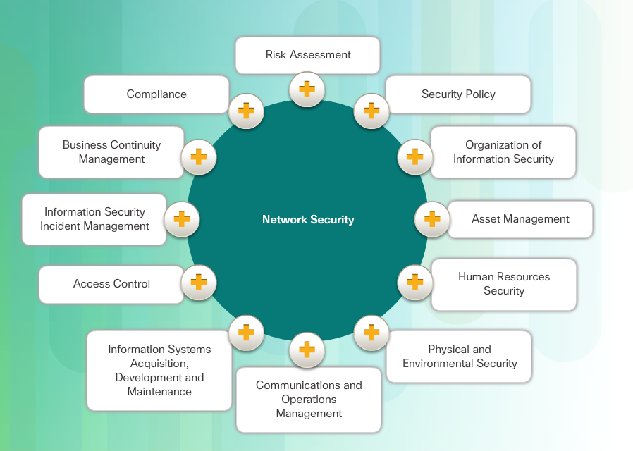
Security Management Framework The ISO Model (Cont.)
ISO/IEC 27000 is an information security standard published in 2005 and revised in 2013. ISO publishes the ISO 27000 standards. Even though the standards are not mandatory, most countries use them as a de facto framework for implementing information security.

Slide 37
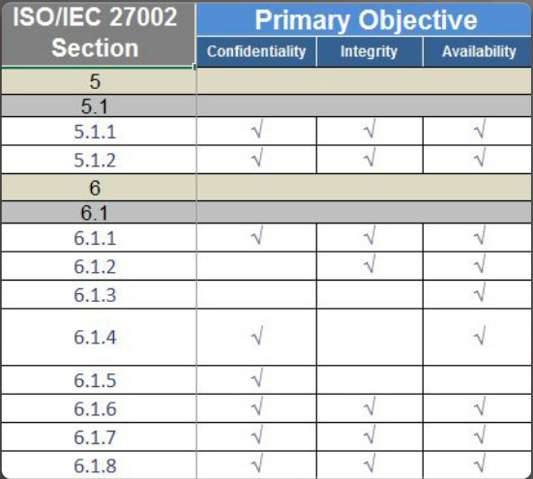
Security Management Framework Using the ISO Cybersecurity Model
The ISO 27000 is a universal framework for every type of organization. In order to use the framework effectively, an organization must narrow down which domains, control objectives, and controls apply to its environment and operations.
The ISO 27001 control objectives serve as a checklist. The first step an organization takes is to determine if these control objectives are applicable to the organization.

Slide 38
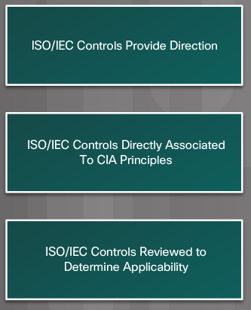
Security Management Framework Using the ISO Cybersecurity Model (Cont.)
The ISO Cybersecurity Model and the States of Data
Different groups within an organization may be responsible for data in each of the various states.
For example, the network security group is responsible for data during transmission.
Programmers and data entry people are responsible for data during processing.
The hardware and server support specialists are responsible for stored data. The ISO Controls specifically address security objectives for data in each of the three states.

Slide 39

Security Management Framework Using the ISO Cybersecurity Model (Cont.)
The ISO Cybersecurity Model and Safeguards
The ISO 27001 control objectives relate directly to the organization’s cybersecurity policies, procedures and guidelines which upper management determines.
The ISO 27002 controls provide technical direction. For example, upper management establishes a policy specifying the protection of all data coming in to or out of the organization. Implementing the technology to meet the policy objectives would not involve upper management.
It is the responsibility of IT professionals to properly implement and configure the equipment used to fulfill the policy directives set by upper management.

Slide 40
2.6 Chapter Summary
Notes:
Cisco Networking Academy Program
Cybersecurity Essentials
Chapter 2: The Cybersecurity Sorcery Cube

Slide 41
Chapter Summary Summary
This chapter discussed the three dimensions of the cybersecurity sorcery cube. The central responsibility of a cybersecurity wizard is to protect an organization’s systems and data.
The chapter explained how each of the three dimensions contributes to that effort.
The chapter also discussed the ISO cybersecurity model. The model represents an international framework to standardize the management of information systems.
This chapter explored the twelve domains. The model provides control objectives that guide the high-level design and implementation of a comprehensive information security management system (ISMS).
The chapter also discussed how security professionals use controls to identify the technologies, devices, and products to protect the organization.
If you would like to further explore the concepts in this chapter, please check out the Additional Resources and Activities page in Student Resources.
Notes:
1.6.1.1 - Summary

Slide 43


